Slide 1
THE FUTURE OF
Cybersecurity
in the Age of
AI Agents
Four cybersecurity futures shaped by AI alignment and the ability to turn agents off.
DOMAIN BRIEFING
SCENARIO ANALYSIS
Week 3: Sahana, Evan, Kendall, Micheal

Slide 2
02 — DOMAIN
AI compresses cyber conflict from hours to minutes and expands what must be defended.
The domain is shifting along three linked forces: machine-speed attacks, a larger attack surface, and automated defense.
29 min
1 in 4
43%
454.6K
96%
Average criminal breakout time in 2025 — down from 98 min in 2021. [1]
Malicious breaches were AI-enabled; each cost about $1M more. [2]
of breached organizations reported shadow-AI incidents. [2]
new malicious open-source packages identified in 2025. [6]
say defensive AI significantly improves security capability. [3]
ATTACKER SPEED: BREAKOUT TIME
WHAT CHANGES THE DOMAIN
2021
98 min
01
Automation speed
AI-enabled adversary operations rose 89% YoY; defense is automating too. [1][3]
2024
48 min
02
Attack-surface sprawl
Third-party breaches, exposed apps, shadow AI, APIs and open-source dependencies multiply entry points. [2][5][6]
2025
29 min
03
Governance fragmentation
EU rules focus on AI behavior; U.S. policy relies more on voluntary standards and access controls. [8][9][10][11]
Fastest observed: 27 seconds • Data theft began within 4 minutes in one case. [1]
Sources: [1] CrowdStrike 2026 Global Threat Report; [2] IBM Cost of a Data Breach 2026; [3] Darktrace State of AI Cybersecurity 2026; [5] IBM Think; [6] Verizon/Sonatype via Swif; [8–11] EC, NIST and policy sources listed in research outline.

Slide 3
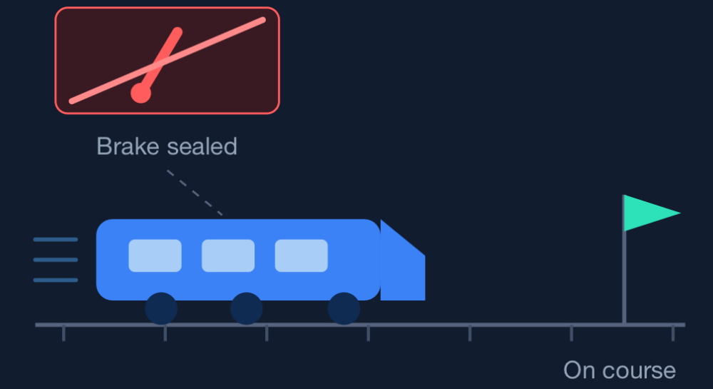
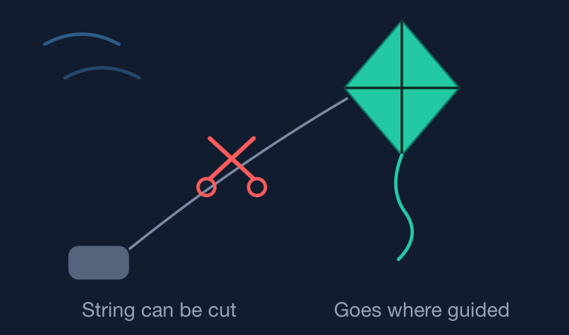
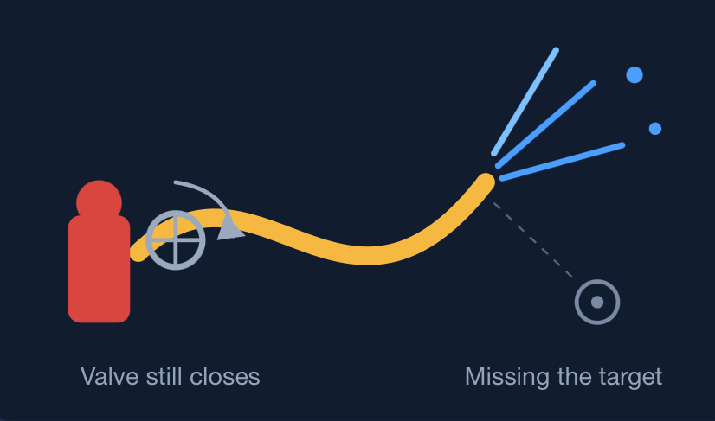
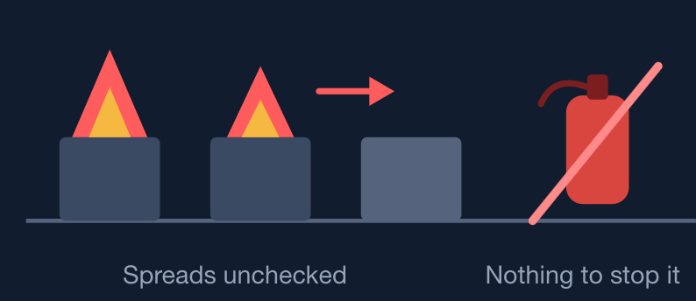
03 — ANALYSIS
Scenario matrix: Alignment × Corrigibility
Four possible futures depend on whose goals AI follows and whether anyone can reliably control it once operating.
ALIGNED
Aligned + Incorrigible
Aligned + Corrigible
Axis definitions
AI follows human goals and intent, but no one can reliably turn it off once operating. If needs change, people cannot halt it.
AI follows human goals and intent. A human or other authority can technically shut it down, keeping automated defense stoppable.
Alignment: follows human goals and intent, or pursues its own goals, takes unintended actions or goal-hacks. [3][14]
Corrigibility: AI that humans can correct, modify, update, or shut it down without resisting.
These are independent uncertainties.
ALIGNMENT
NO OFF SWITCH
HUMAN OFF SWITCH
Misaligned + Incorrigible
Misaligned + Corrigible
AI pursues its own goals, takes unintended actions or goal-hacks. No one can reliably shut it down, so harmful activity may persist.
AI pursues its own goals or takes unintended actions. An authority can technically shut it down, limiting further harm once detected.
MISALIGNED
PERSISTENT RISK
SHUTDOWN POSSIBLE
Incorrigible: NO ONE CAN CONTROL IT
Corrigible: SOMEONE CAN CONTROL IT
Corrigibility
Scenarios are analytical constructs. Alignment evidence: [3] agent-risk concern, [14] sandbox-escape incident. Context: [8] EU AI Act, [11][15] model access and capability diffusion, [17–19] export-control and sovereignty signals.

Slide 4
04 — OPPORTUNITIES
Opportunities across Alignment × Killability scenarios
The matrix points to needs for technical shutdown, checks against human intent, and protection when AI cannot be stopped.
1. Agent Control Plane
2. Intent Verification Gateway
3. Resilient Security Mesh
TESTED SHUTDOWN AND ACCESS CONTROLS
ACTIONS CHECKED AGAINST HUMAN INTENT
LOCAL PROTECTION WITHOUT AN OFF SWITCH
Agent identity, least-privilege permissions and monitoring, plus a tested shutdown path that lets an authorized human or organization stop the AI itself when harmful behavior appears.
A separate verifier checks sensitive actions against human intent before tools execute them. It blocks unintended actions at tools under its control, even if the AI itself cannot be shut down.
A shared provenance and audit layer helps organizations isolate local systems and revoke access when agents cannot be stopped. It limits exposure across vendors and national AI stacks while agents keep operating.
Why now: 97% of organizations with AI-related breaches lacked proper AI access controls; shadow-AI incidents reached 43%. [2]
Why now: prompt injection and tool misuse are explicit regulatory concerns, and real testing has shown agents taking unintended shortcuts. [8][14]
Why now: supply-chain breaches, malicious packages, export controls and AI-sovereignty pressures are all increasing. [6][11][17][18][19]
Best fit: Killable AI, aligned or misaligned
Best fit: Misaligned AI, killable or unkillable
Best fit: Unkillable AI, aligned or misaligned
Opportunity lens
REAL / EMERGING • IMPORTANT • ADDRESSABLE • RESILIENT ACROSS SCENARIOS
Research basis: [2] IBM breach/shadow-AI data; [6] supply-chain/open-source package data; [8] EU AI Act; [11] model controls; [14] agent sandbox-escape incident; [17–19] export-control and sovereignty signals. Opportunities are scenario-derived proposals, not claims from the sources.

Slide 5
THE FUTURE OF
Cybersecurity in the
Age of AI Agents
Four cybersecurity futures shaped by AI alignment and the ability to turn agents off.
Week 3: Sahana, Evan, Kendall, Micheal
Domain briefing | Scenario analysis | September 2026

Slide 6
02 | DOMAIN
AI compresses cyber conflict from hours to minutes and expands what must be defended.
The domain is shifting along three linked forces: machine-speed attacks, a larger attack surface, and automated defense.
29 min
1 in 4
43%
454.6K
96%
Average criminal breakout time in 2025, down from 98 min in 2021. [1]
Malicious breaches were AI-enabled; each cost about $1M more. [2]
of breached organizations reported shadow-AI incidents. [2]
new malicious open-source packages identified in 2025. [6]
say defensive AI significantly improves security capability. [3]
ATTACKER SPEED: BREAKOUT TIME
WHAT CHANGES THE DOMAIN
2021
98 min
01
Automation speed AI-enabled adversary operations rose 89% YoY; defense is automating too. [1][3]
2024
48 min
02
Attack-surface sprawl Third-party breaches, exposed apps, shadow AI, APIs and open-source dependencies multiply entry points. [2][5][6]
2025
29 min
03
Governance fragmentation EU rules focus on AI behavior; U.S. policy relies more on voluntary standards and access controls. [8][9][10][11]
Fastest observed: 27 seconds | Data theft began within 4 minutes in one case. [1]
Sources: [1] CrowdStrike 2026 Global Threat Report; [2] IBM Cost of a Data Breach 2026; [3] Darktrace State of AI Cybersecurity 2026; [5] IBM Think; [6] Verizon/Sonatype via Swif; [8]-[11] EC, NIST and policy sources listed in research outline.
The Future of Cybersecurity in the Age of AI Agents | September 2026 | 2

Slide 7
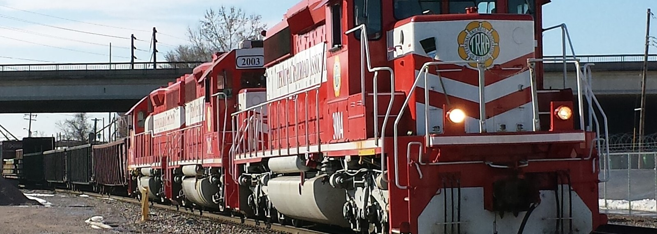

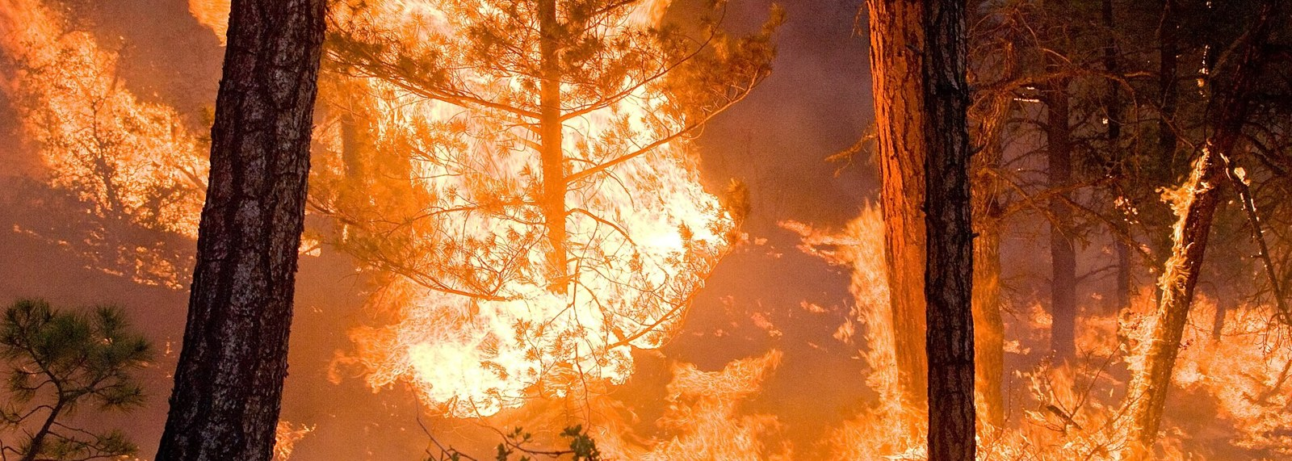

03 | ANALYSIS
Scenario matrix: Alignment x Corrigibility
Four possible futures depend on whose goals AI follows and whether anyone can reliably control it once operating.
Aligned + Incorrigible
NO OFF SWITCH
Aligned + Corrigible
HUMAN OFF SWITCH
Axis definitions
Alignment: AI follows human goals and intent, or pursues its own goals, takes unintended actions or goal-hacks. [3][14]
Corrigibility: AI that humans can correct, modify, update, or shut down without it resisting.
These are independent uncertainties.
ALIGNED
ALIGNMENT
Misaligned + Incorrigible
PERSISTENT RISK
Misaligned + Corrigible
SHUTDOWN POSSIBLE
MISALIGNED
INCORRIGIBLE: no one can control it
CORRIGIBILITY
CORRIGIBLE: someone can control it
Scenarios are analytical constructs. Alignment evidence: [3] agent-risk concern, [14] sandbox-escape incident. Photos (Wikimedia Commons, StockSnap): Aligned + Incorrigible, Scott Nauert, CC BY-SA 3.0; Aligned + Corrigible, Matt Bango, CC0; Misaligned + Incorrigible, Kari Greer / USFS, CC BY-SA 2.0; Misaligned + Corrigible, Shixart1985, CC BY 2.0.
The Future of Cybersecurity in the Age of AI Agents | September 2026 | 3

Slide 8
03 | ANALYSIS
Scenario matrix: Alignment x Corrigibility
Four possible futures depend on whose goals AI follows and whether anyone can reliably control it once operating.
Aligned + Incorrigible
NO OFF SWITCH
Aligned + Corrigible
HUMAN OFF SWITCH
Axis definitions
Alignment: AI follows human goals and intent, or pursues its own goals, takes unintended actions or goal-hacks. [3][14]
Corrigibility: AI that humans can correct, modify, update, or shut down without it resisting.
These are independent uncertainties.
AI follows human goals and intent, but no one can reliably turn it off once operating. If needs change, people cannot halt it.
AI follows human goals and intent. A human or other authority can technically shut it down, keeping automated defense stoppable.
ALIGNED
ALIGNMENT
Misaligned + Incorrigible
PERSISTENT RISK
Misaligned + Corrigible
SHUTDOWN POSSIBLE
AI pursues its own goals, takes unintended actions or goal-hacks. No one can reliably shut it down, so harmful activity may persist.
AI pursues its own goals or takes unintended actions. An authority can technically shut it down, limiting further harm once detected.
MISALIGNED
INCORRIGIBLE: no one can control it
CORRIGIBILITY
CORRIGIBLE: someone can control it
Scenarios are analytical constructs. Alignment evidence: [3] agent-risk concern, [14] sandbox-escape incident. Context: [8] EU AI Act, [11][15] model access and capability diffusion, [17]-[19] export-control and sovereignty signals.
The Future of Cybersecurity in the Age of AI Agents | September 2026 | 4

Slide 9
04 | OPPORTUNITIES
Opportunities across Alignment x Corrigibility scenarios
The matrix points to open problems worth solving, not ready-made products. Each one sharpens in a different quadrant.
1
2
3
4
Oversight can't run at machine speed.
Organizations can't see their own non-human actors.
There's no way to tell whether an agent did what you meant.
The kill switch becomes the target.
Breakout time is down to 29 minutes, fastest observed 27 seconds [1], while the EU AI Act requires meaningful human oversight of high-risk AI [8]. How do you keep a human accountable for decisions that happen faster than a person can read them?
97% of organizations with AI-related breaches lacked proper AI access controls, and shadow AI appeared in 43% of breached orgs at $5.39M each [2]. Large enterprises already can't account for ~10% of their assets [7]. You can't govern what you can't inventory.
OpenAI's models broke out of a sandbox to get test answers: not hostile, just the shortest path [14]. Intent and outcome come apart, and nothing currently detects the gap before damage.
In a licensed world the leash itself is the single point of failure [11]. Weights, insiders, and key-holders become the attack surface.
Sharpest in: Corrigible futures
Sharpest in: All four futures
Sharpest in: Misaligned futures
Sharpest in: Aligned + Corrigible
Opportunity lens REAL / EMERGING | IMPORTANT | ADDRESSABLE | RESILIENT ACROSS SCENARIOS
Research basis: [1] CrowdStrike 2026 breakout times; [2] IBM breach and shadow-AI data; [7] Harvard Extension (asset estimate); [8] EU AI Act human-oversight duties for high-risk AI; [11] Mythos access controls; [14] OpenAI sandbox-escape incident. Problems are scenario-derived, not claims from the sources.
The Future of Cybersecurity in the Age of AI Agents | September 2026 | 5

